Slide 1
RADAR
(Radio Detection and Ranging)

Slide 2
RADAR
Robert Watson-Watt’s note on Aircraft’s Detection & Location by Radio Methods published more than 50 years ago. It was the most significant solitary publication in this field.

Slide 3
RADAR
RADAR stands for Radio Detection and Ranging System. It is basically an electromagnetic system used to detect the location and distance of an object from the point where the RADAR is placed. It works by radiating energy into space and monitoring the echo or reflected signal from the objects. It operates in the UHF and microwave range.

Slide 4
RADAR
A radar is an electromagnetic sensor, used to notice, track, locate, and identify different objects which are at certain distances. The working of radar is, it transmits electromagnetic energy in the direction of targets to observe the echoes and returns from them. Here the targets are nothing but ships, aircraft, astronomical bodies, automotive vehicles, spacecraft, rain, birds, insects, etc. Instead of noticing the target’s location and velocity, it also obtains their shape and size sometimes.

Slide 5
RADAR
The main objective of radar as compared with infrared and optical sensing devices is to discover faraway targets under difficult climate conditions & determines their distance, range, through precision. Radar has its own transmitter which is known as a source of illumination for placing targets. Generally, it works in the microwave area of the electromagnetic spectrum that is calculated in hertz when frequencies extend from 400 MHz to 40 GHz.
The radio signals used by radar normally range from centimeters to meters. The radio signals travel outside from the antenna with 300,000 km per second speed until they strike something and some of them return back to the antenna.

Slide 6
RADAR Principle
The electronic principle on which radar operates is very similar to the principle of sound-wave reflection. If you shout in the direction of a sound-reflecting object (like a rocky canyon or cave), you will hear an echo. If you know the speed of sound in air, you can then estimate the distance and general direction of the object. The time required for an echo to return can be roughly converted to distance if the speed of sound is known.

Slide 7
Design Elements
A Transmitter: It can be a power amplifier like a Klystron, Travelling Wave Tube, or a power Oscillator like a Magnetron. The signal is first generated using a waveform generator and then amplified in the power amplifier which produce high-power RF pulses .
Waveguides: The waveguides are transmission lines for transmission of the Radar signals.
Radar Antenna: The antenna used can be a parabolic reflector, planar arrays, or electronically steered phased arrays. The Antenna transfers the transmitter energy to signals in space with the required distribution and efficiency. This process is applied in an identical way on reception.
Duplexer: A duplexer allows the antenna to be used as a transmitter or a receiver. This switching is necessary that would produce a short circuit at the input to the receiver when the transmitter is working.

Slide 8
Design Elements
Receiver: It can be a super heterodyne receiver or any other receiver which consists of a processor to process the signal and detect it. The receiver provides video signals on the output.
Threshold Decision: The output of the receiver is compared with a threshold to detect the presence of any object. If the output is below any threshold, the presence of noise is assumed.
Indicator The indicator should present to the observer a continuous, easily understandable, graphic picture of the relative position of radar targets.

Slide 9
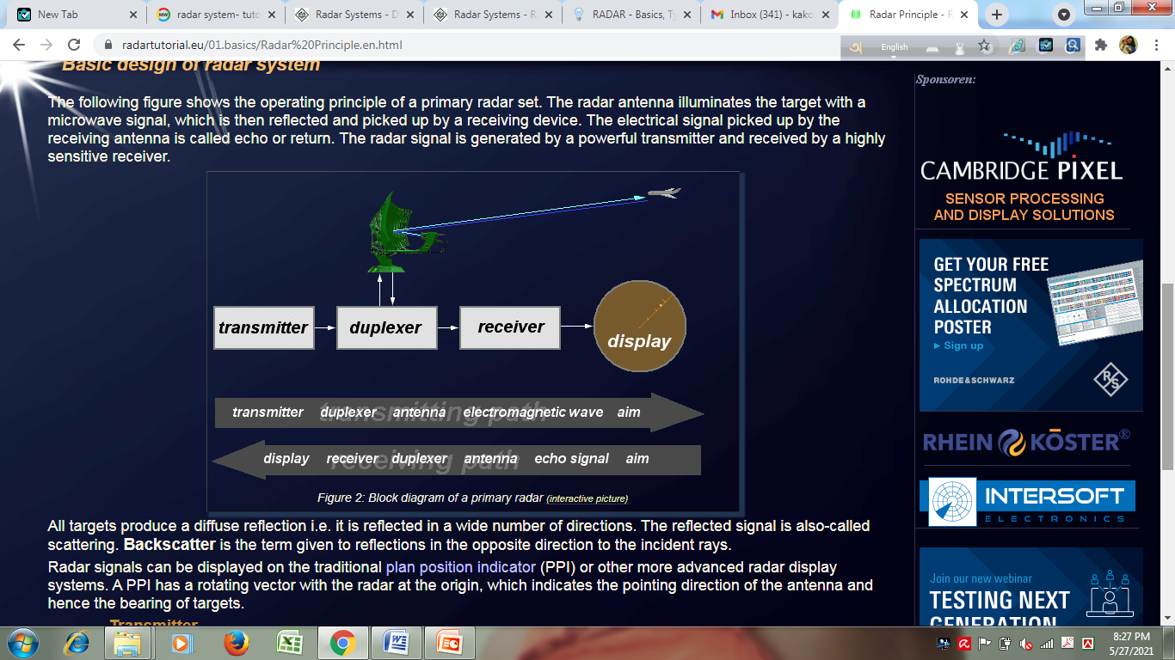

Slide 10
Derivation of Radar Range Equation

Slide 11
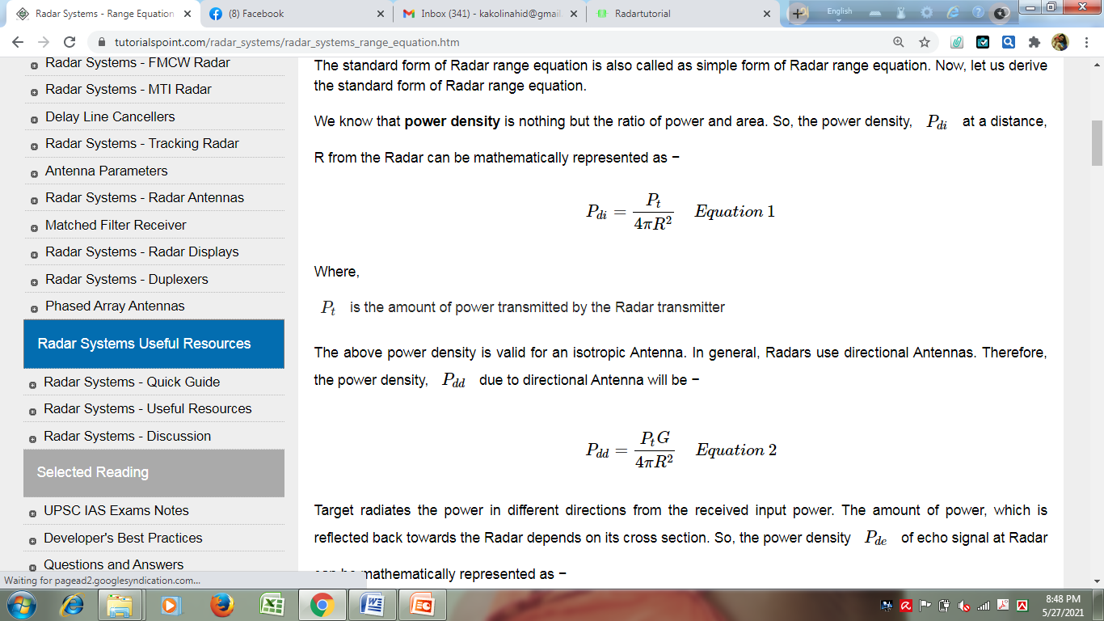
Derivation of Radar Range Equation

Slide 12
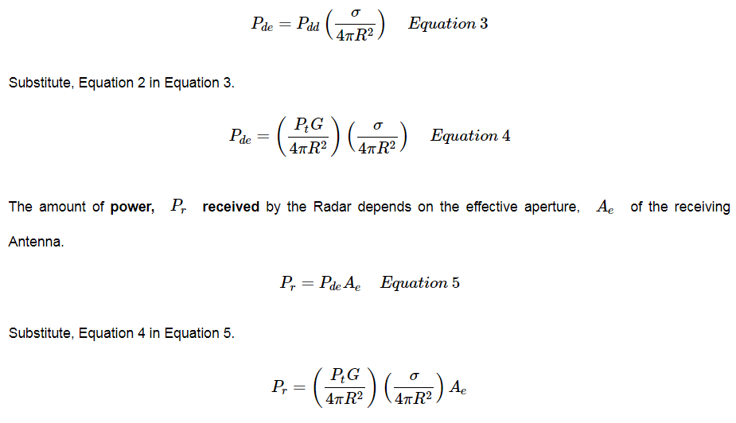
Derivation of Radar Range Equation
Radar cross section of the target=σ

Slide 13
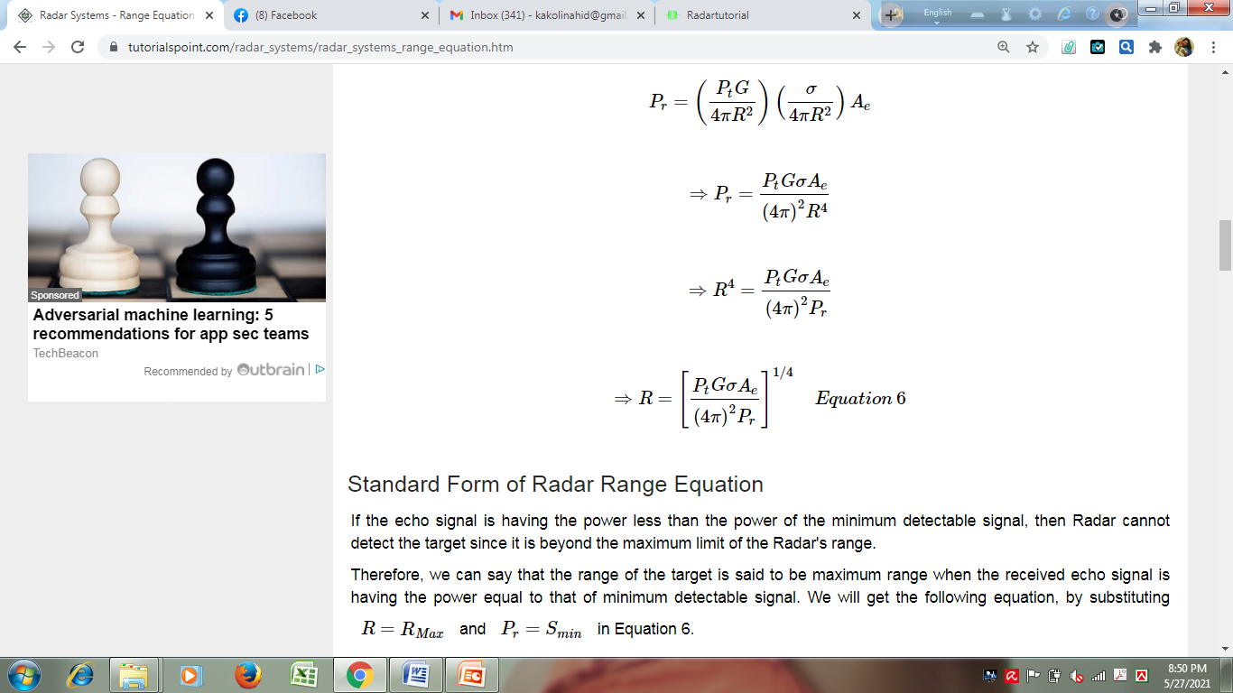
Derivation of Radar Range Equation

Slide 14
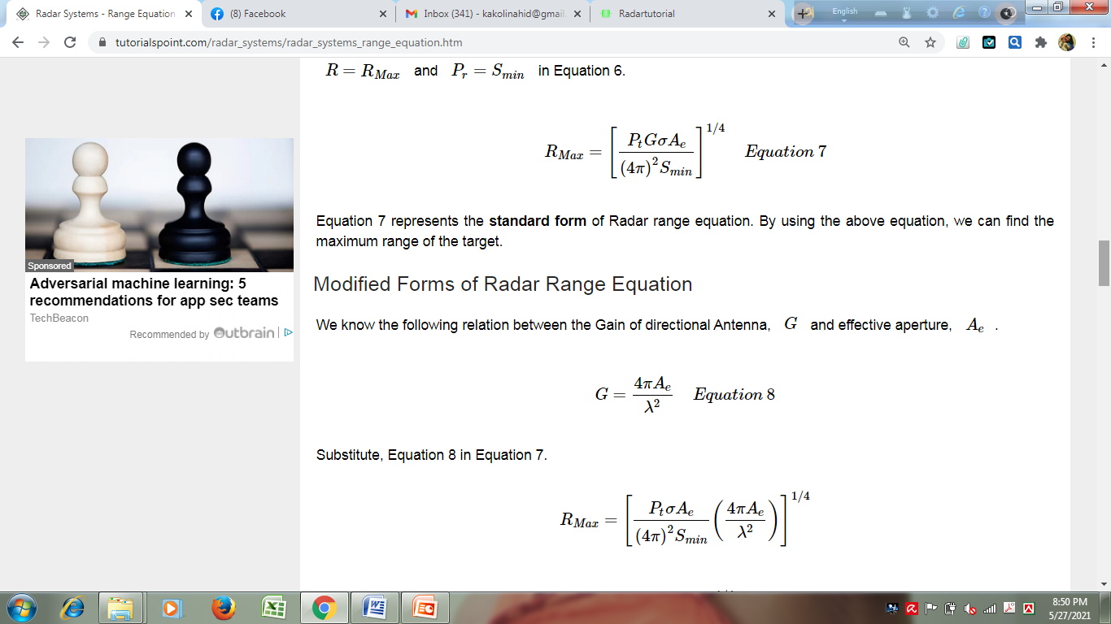
Derivation of Radar Range Equation

Slide 15
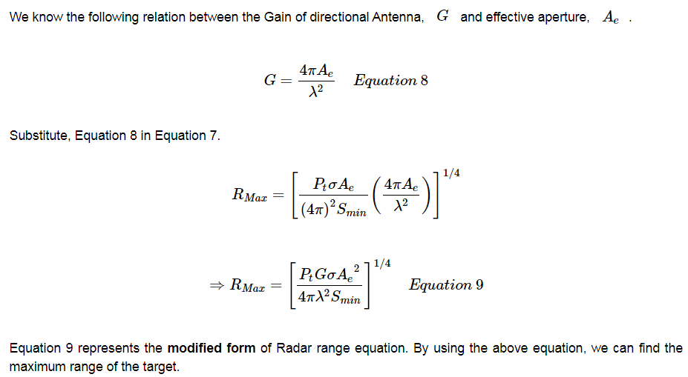
Modified form of Radar Range Equation
See the eq. of horn antenna

Slide 16
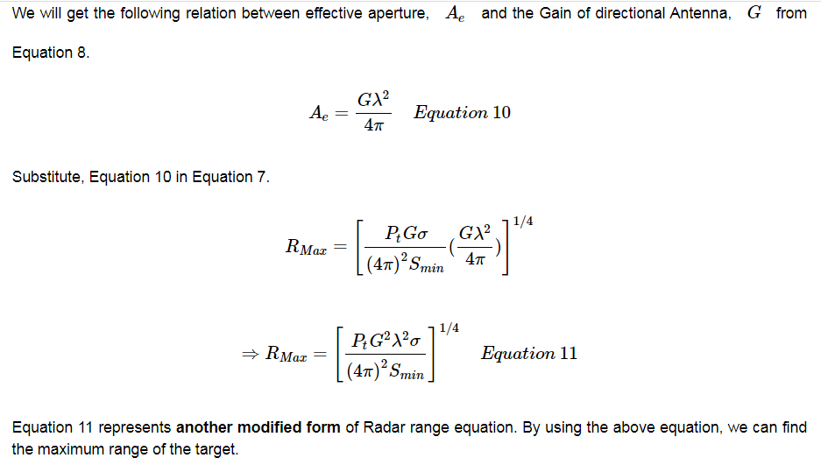
Modified form of Radar Range Equation

Slide 17
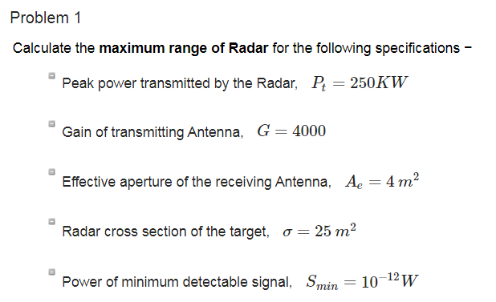
Home Work

Slide 18
Types of RADAR
Bistatic Radar
Doppler Radar
Monopulse Radar
Passive Radar
Instrumentation Radar
Weather Radars
Mapping Radar
Navigational Radars
Pulsed Radar
Pulse-Doppler
Moving Target Indicator (MTI) Radar
Continuous Wave (CW) Radar

Slide 19
Pulsed Radar

Slide 20
Pulse Radar
The Radar, which operates with pulse signal is called the Pulse Radar. Pulse Radars can be classified into two types-
1. Basic Pulse Radar
2. Moving Target Indication Radar

Slide 21
Basic Pulse Radar
(Stationary Target)
The Radar, which operates with pulse signal for detecting stationary targets, is called the Basic Pulse Radar or simply, Pulse Radar. It uses single antenna for both transmitting and receiving signals with the help of duplexer. Antenna will transmit a pulse signal at every clock pulse. The duration between the two clock pulses should be chosen in such a way that the echo signal corresponding to the present clock pulse should be received before the next clock pulse.

Slide 22
Moving Target Indicator
The Radar, which operates with pulse signal for detecting non-stationary targets, is called Moving Target Indication Radar or simply, MTI Radar. It uses single antenna for both transmission and reception of signals with the help of duplexer.
MTI Radar uses the principle of Doppler effect for distinguishing the non-stationary targets from stationary objects.

Slide 23
Moving Target Indicator
It transmits low pulse repetition frequency to avoid range ambiguities. In an MTI RADAR system, the received echo signals from the object are directed towards the mixer, where they are mixed with the signal from a stable local oscillator (STALO) to produce the IF signal.
This IF signal is amplified and then given to the phase detector where its phase is compared with the phase of the signal from the Coherent Oscillator (COHO) and the difference signal is produced. The Coherent signal has the same phase as the transmitter signal. The coherent signal and the STALO signal are mixed and given to the power amplifier which is switched on and off using the pulse modulator.

Slide 24
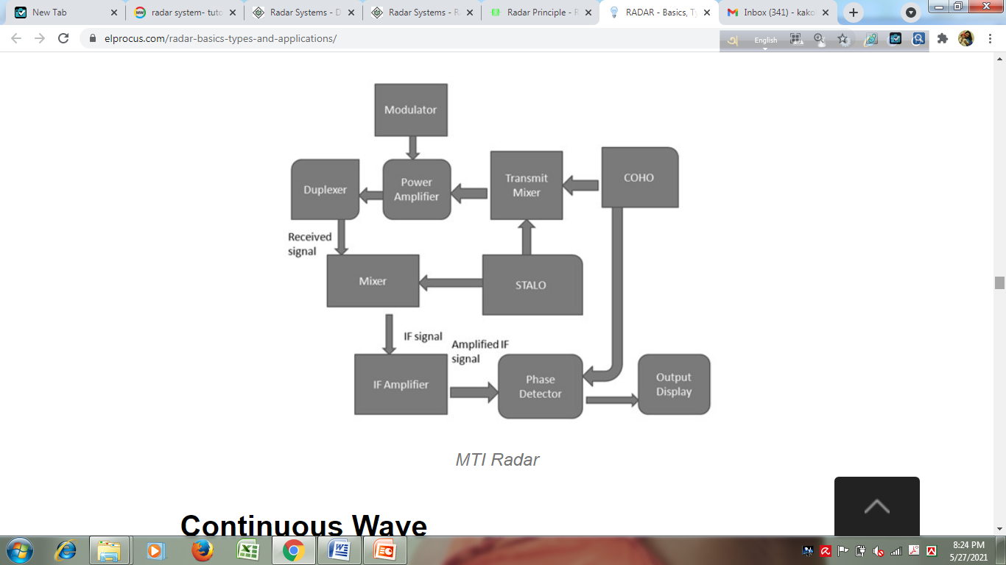
8
Tx
6
7
1
3
2
Rx
2&3
4
5

Slide 25
Tracking Radar

Slide 26
Tracking Radar
The Radar, which is used to track the path of one or more targets is known as Tracking Radar. In general, it performs the following functions before it starts the tracking activity.
1. Target detection
2. Range of the target
3. Finding elevation and azimuth angles
4. Finding Doppler frequency shift
So, Tracking Radar tracks the target by tracking one of the three parameters — range, angle, Doppler frequency shift. Most of the Tracking Radars use the principle of tracking in angle.

Slide 27
Tracking Radar
Angular Tracking
The pencil beams of Radar Antenna perform tracking in angle. The axis of Radar Antenna is considered as the reference direction. If the direction of the target and reference direction is not same, then there will be angular error, which is nothing but the difference between the two directions.
If the angular error signal is applied to a servo control system, then it will move the axis of the Radar Antenna towards the direction of target. Both the axis of Radar Antenna and the direction of target will coincide when the angular error is zero. There exists a feedback mechanism in the Tracking Radar, which works until the angular error becomes zero.

Slide 28
Angular Tracking
Following are the two techniques, which are used in angular tracking.
1. Sequential Lobing
2. Conical Scanning
1. Sequential Lobing
If the Antenna beams are switched between two patterns alternately for tracking the target, then it is called sequential lobing. It is also called sequential switching and lobe switching. This technique is used to find the angular error in one coordinate. It gives the details of both magnitude and direction of angular error.

Slide 29
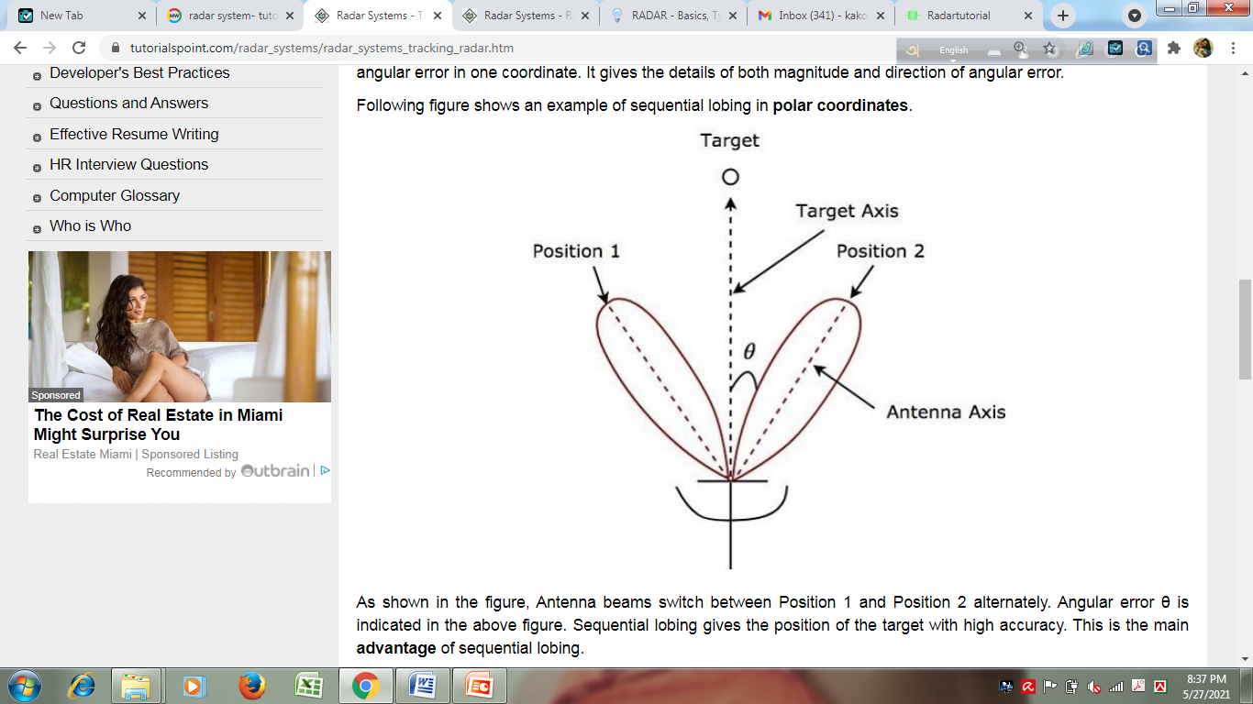
sequential lobing in polar coordinates.

Slide 30
Angular Tracking
From the figure, Antenna beams switch between Position 1 and Position 2 alternately (between two lobes). Angular error θ is indicated in the above figure. Sequential lobing gives the position of the target with high accuracy. This is the main advantage of sequential lobing.
2. Conical Scanning
If the Antenna beam continuously rotates for tracking a target, then it is called conical scanning. Conical scan modulation is used to find the position of the target. Following figure shows an example of conical scanning.

Slide 31
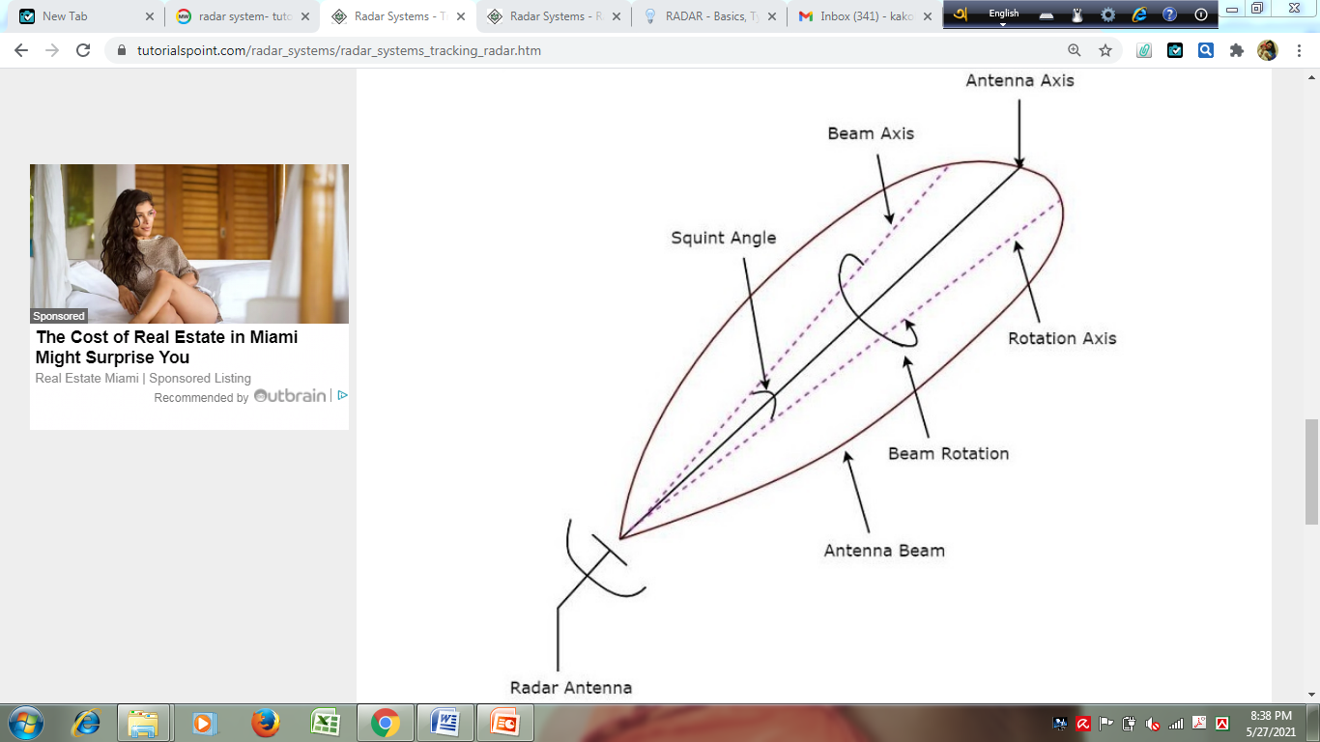

Slide 32
Squint angle
Squint angle is the angle between beam axis and rotation axis and it is shown in the above figure. The echo signal obtained from the target gets modulated at a frequency equal to the frequency at which the Antenna beam rotates.
The angle between the direction of the target and the rotation axis determines the amplitude of the modulated signal. So, the conical scan modulation has to be extracted from the echo signal and then it is to be applied to servo control system, which moves the Antenna beam axis towards the direction of the target.

Slide 33
Application
Military Applications
It has 3 major applications in the Military:
In air defense, it is used for target detection, target recognition, and weapon control (directing the weapon to the tracked targets).
In a missile system to guide the weapon.
Identifying enemy locations on the map.
Air Traffic Control
It has 3 major applications in Air Traffic control:
To control air traffic near airports. The Air Surveillance RADAR is used to detect and display the aircraft’s position in the airport terminals.
To guide the aircraft to land in bad weather using Precision Approach RADAR.
To scan the airport surface for aircraft and ground vehicle positions.

Slide 34
Application
Remote Sensing
It can be used for observing weather or observing planetary positions and monitoring sea ice to ensure a smooth route for ships.
Ground Traffic Control
It can also be used by traffic police to determine the speed of the vehicle, controlling the movement of vehicles by giving warnings about the presence of other vehicles or any other obstacles behind them.
Space
It has 3 major applications:
To guide the space vehicle for a safe landing on the moon
To observe the planetary systems
To detect and track satellites

